Slide 1

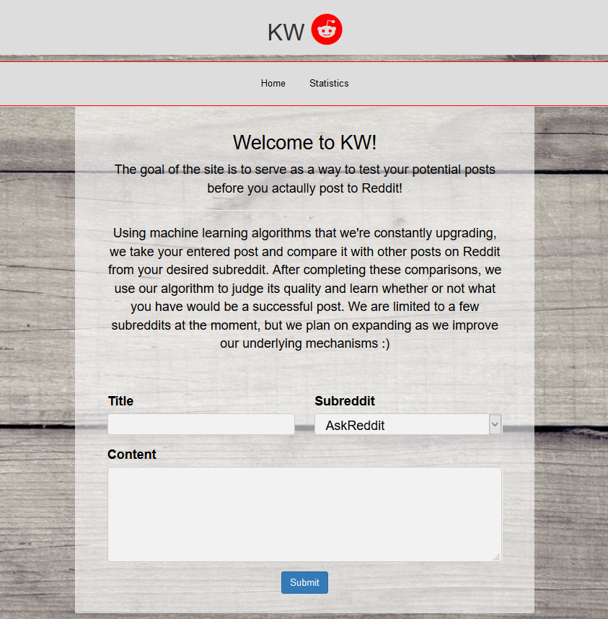
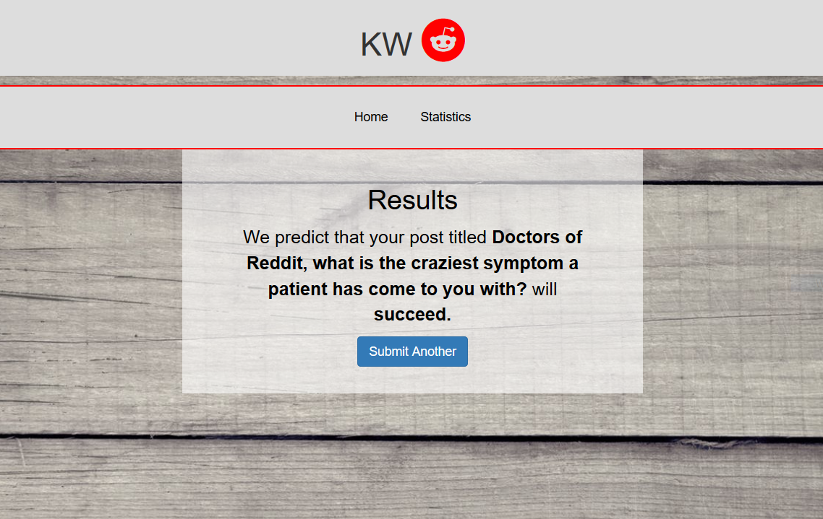
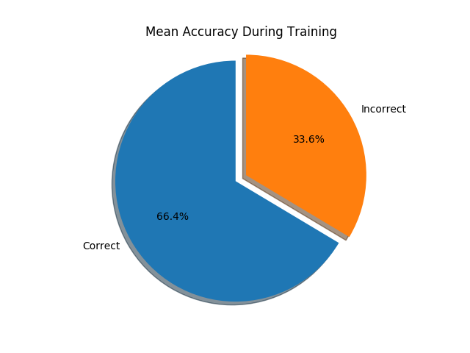
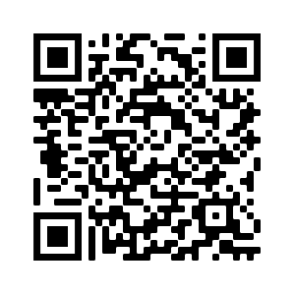
KW
Approaching Text Based Subreddits Through Machine Learning
Hagan Brewer, Joshua Brucker, Solomon Kim, Nelson Vargas
Abstract: A large part of reddit's success as a "social news aggregation, web content rating, and discussion website" should be accredited to the implementation of karma as a powerful reward system that the users can use to control what content can be viewed. Posts and inevitably users that gain large number of upvotes (a large karma score) are viewed with greater frequency and in higher regard respectively. Our team endeavors to build a machine learning system to grade the degree to which a new reddit post will be popular within its respective subreddit. Our team intends to quantify what makes a reddit post successful and give the users the opportunity to test their content before making the posts public.
Figure 1: Home Page
Approach: Using a combination of naïve Bayes and logistic regression models in combination with a data scrapper, a user enters their potential posts content into our web app. Our algorithm then analysis the highest and lowest rated posts over the last two years of reddit post history to determine trends. The algorithm then runs the users input through a similar process comparing the input to the results of the initial reddit analysis. The algorithm then returns the likely hood of the users input to succeed or not succeed based on our definition of accumulating more than 400 karma.
Figure 2: Results Page
Technologies:
Python
Bootstrap/HTML/CSS
Flask
Natural Language Processing
Features:
Title Analysis
Access to complete Reddit archive
Uses Real Time Data
Conclusion/Findings: Through this assignment, our team had the opportunity to delve into a realistic development setting. Using this assignment as an opportunity to learn machine learning, we faced many real world challenges such as learning new technologies, connecting technologies, and technical debt. While we were able to learn a lot of the impressive hands-on capabilities of machine learning and natural language processing, we were also given the opportunity to experience and prepare for what life as a developer outside of college might truly be like.
Figure 3: Graph Representing Results
Future Work: We would like to expand our machine learning algorithms to include Images from visual subreddits such as r/Pics
Visit our Repo at https://github.com/csc4790-fall2019/sp-hagan-solomon-josh-nelson/wiki or Scan the QR Code
We would like to acknowledge the follow people for their help: Dr. Benjamin Mitchell, Jason Dobies, Villanova Computer Science Department

